Slide 1
Fivetran HVR Training
v1.2
Last updated: 09/12/24
Platform Operations

Slide 2
Platform Operations
Intro to Platform Operations
HVR Deployment
Preparation
Installation on Linux Installation on Windows
HVR Configuration
Setting up the HVR Hub Setting up an Agent
Log Rotation
HVR Upgrade / Uninstall
Upgrading HVR Uninstalling HVR
This module provides an in-depth look at the day to day management of Fivetran HVR’s replication platform components.

Slide 3
Intro to Platform Operations

Slide 4







Intro to Platform Operations
Infrastructure Management
HVR Install, Patching & Upgrade
Backup & Disaster Recovery
Monitoring and managing system resources of key infrastructure pieces.
Keeping up-to-date about HVR’s product lifecycle. Testing and upgrading patches or new major releases.
Ensuring continuity of data replication by having a comprehensive strategy in place to recover in case of unforeseen events.
Performance Optimization
Security & Access Control
Deployment Automation
Ensuring that infrastructure is sized correctly, for an optimal cost to performance ratio.
Ensuring that infrastructure adheres to the latest security policies and best practices. Controlling access to system.
Creating automation templates, or backup-restore points (images) to achieve RTO objective.

Slide 5
Get the Basics Right
Manage Infra
Security is Key
Keep Backups
Make sure that proper means of monitoring are in place to track CPU, memory, disk utilization. Set thresholds for usage limit notifications. Automate whatever is possible.
Keep your O/S, utilities, security up-to-date.. Make sure to limit the number of users that can make changes on your Hub server. Rotate your HVR DB user passwords.
Use HVR’s export features to keep daily, or even more frequent exports or backups of your Hubs on an off server location.

Slide 6
HVR Deployment
Preparation

Slide 7
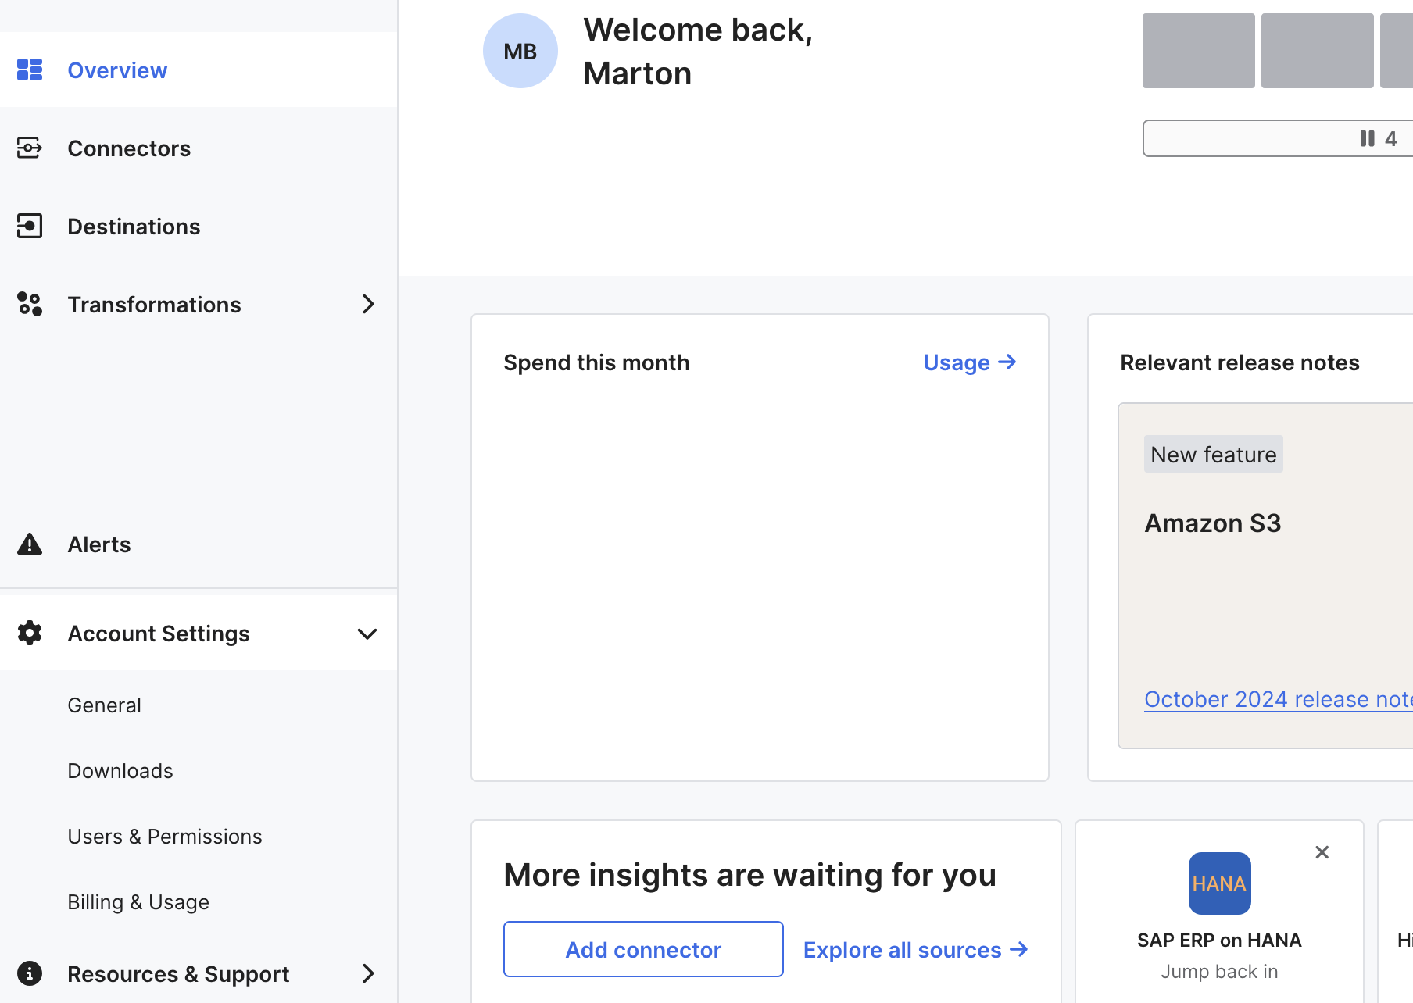
Using fivetran.com
Having access to the Fivetran site company account is essential to operate your platform.
Gives you access to download new HVR releases - including both GA and EA versions.
Provides the ability to add new fivetran.com users and change permissions.
If you have hubs registered, you will see your usage and billing (CBP customers).

Slide 8






Preparation
Checklist for preparation
Disk space
Platform support
Installation package
Check if you have enough space to install HVR. The hvr_home folder consumes about 400 MB of disk space.
Check which HVR version is compatible with the host OS and database and check the prerequisites, such as glibc version.
Download the installation package from the Fivetran website.
License
Network
Elevated privileges
For subscription based pricing, obtain the license file. For consumption based pricing, open the firewall outbound to the Fivetran servers.
Make sure that agent or database port numbers are open between the hub and agents and the hubserver service port is open between the hub and desktops.
Obtain root permission for configuring the agent/hub listener as a service. (optional)

Slide 9
GA
EA
General Availability Release.
For use in most prod environments. Introduces bug fixes. 6.1.0 / 6.2.0 branches.
Early Adopter Version. Mostly used in test environments. Also introduces major new features. 6.2.5 branch.

Slide 10




Phone Home setup
Mandatory for consumption-based license customers.
Hub registration: 35.236.237.87
Consumption data: 34.110.137.135 34.120.211.189
Hub
NAT gateway
Web browser
CLI
User desktop
Proxy server

Slide 11


Consumption Based Pricing
Monthly Active Rows
What is MAR?
Calculation
MAR (Monthly Active Rows) is the number of distinct primary keys synced from the source system to the destination in a given calendar month.
MAR is an incremental new row (insert) or any incremental row update/delete. Each row is counted only once, regardless of how many changes occur on that row in a single month.

Slide 12



MAR in HVR
When data is replicated from one source to multiple destinations, MAR is calculated separately for each destination.
Fivetran determines MAR for HVR hubs using metadata sent to the Fivetran server.
Fivetran provides a 14-day free trial for new HVR connectors and a 5-day troubleshooting window for table refreshes at no cost, starting from the first refresh of a table in a given month. Any refreshes beyond this window are charged towards the paid MAR.
HVR uploads consumption data hourly and the Fivetran server sends back a 7-day license key daily a part of this data exchange.

Slide 13
HVR Deployment
Installation

Slide 14
Installation on Linux
1
2
Create HVR installation directories hvr_home, hvr_config and hvr_tmp and uncompress the HVR installation package into hvr_home.
Set $HVR_HOME, $HVR_CONFIG, $HVR_TMP environment variables and add HVR_HOME/bin to the environment variable PATH.
3
4
Set the HTTP and/or HTTPS port number (Hub) or listener port number (Agent).
Configure hvrhubserver/hvragentlistener as service (optional but recommended).
Start hvrhubserver/hvragentlistener.
Schedule hvralertmanager (optional but recommended).
The steps can be found with more details in the online documentation.

Slide 15
Installation on Linux
HTTP listening port
After installing HVR on Linux, a few extra steps are required to start up the hvrhubserver process.
At least the HTTP listening port property must be set. This can be done on CLI using
hvrhubserverconfig HTTP_Port=4340
HTTPS certificate pair
Using HTTPS_Port requires adding the right certificates. These go into folder $HVR_CONFIG/etc/cert/ as files hvrhubserver.priv_key and .pub_cert
Auto-Start
HVR will not auto-start by default. Hvrhubserver must either be set up as a systemd service, or started by a custom script.

Slide 16
Installation on Windows
1
2
Specify the directory for HVR_HOME, HVR_CONFIG, HVR_TMP folders.
Choose from role Hub Machine / High Volume Agent / Neither.
Set the HTTP or HTTPS port number (Hub) or listener port number (Agent)
3
4
Set the frequency for the alert manager. (optional)
Choose the owner for the hvrhubserver/hvragentlistener service.
Add HVR_HOME, HVR_CONFIG, HVR_TMP to system variables (optional).
Create a desktop icon (optional).
The steps can be found with more details in the online documentation.

Slide 17
HVR Configuration

Slide 18
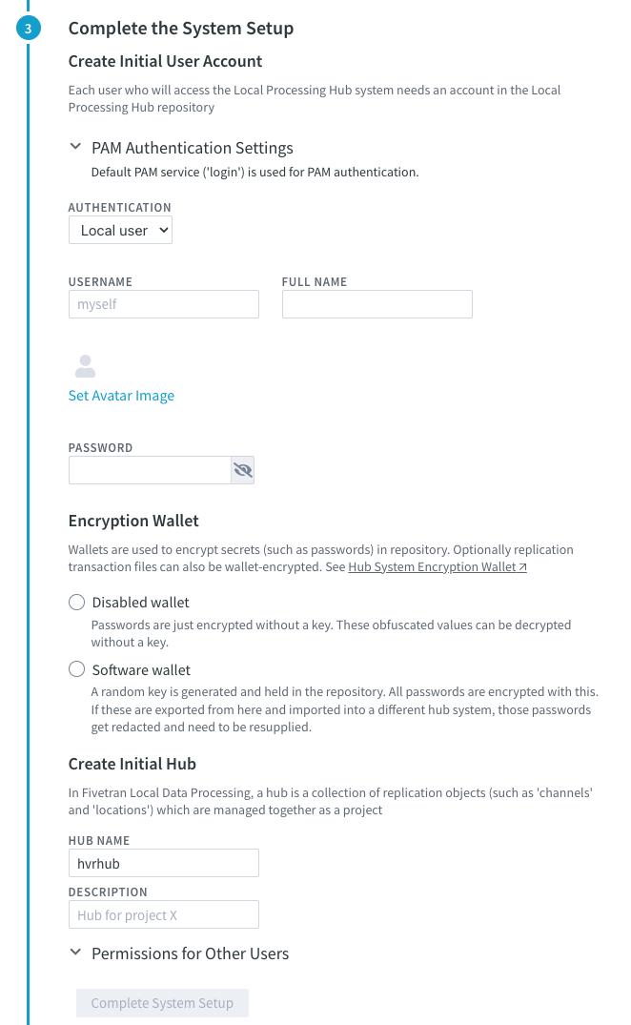
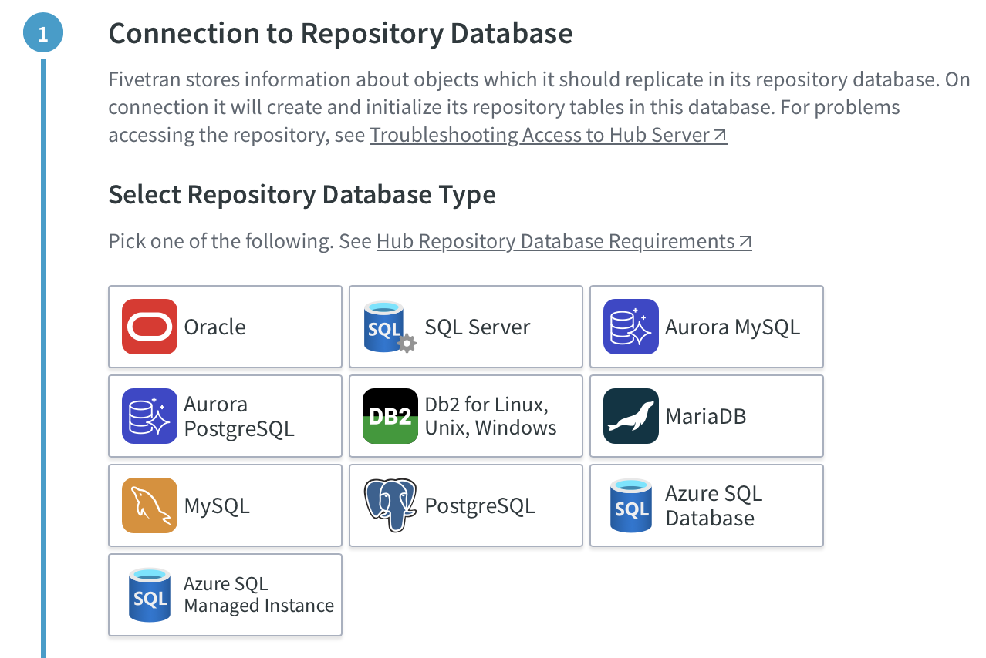
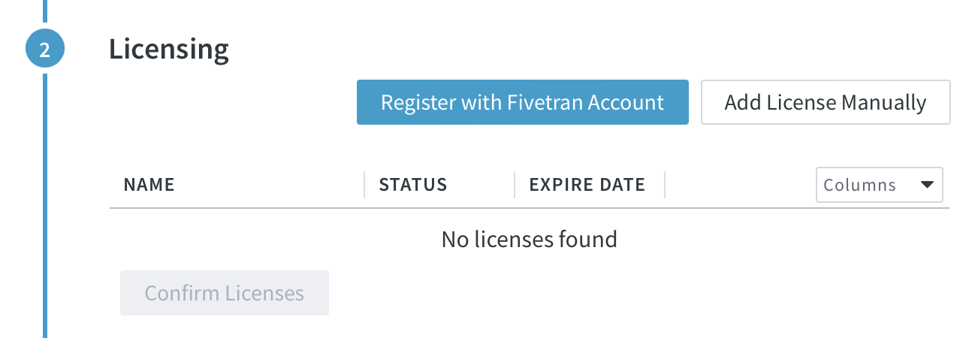
Configuration
Initial setup of the HVR Hub
During the initial login to the UI, HVR will walk the user through the initial configuration workflow.
In this workflow, the user will have to perform the following steps:
Configure connection to the repository database
Licensing (upload lic file or register hub)
Create initial user account and hub, enable encryption wallet (optional)

Slide 19
The auto-generated password is stored in a .cred file in $HVR_CONFIG/wallet.
Create regular backups of the cred file. If the file is lost or corrupted then HVR won’t be able to open the wallet anymore.

Slide 20
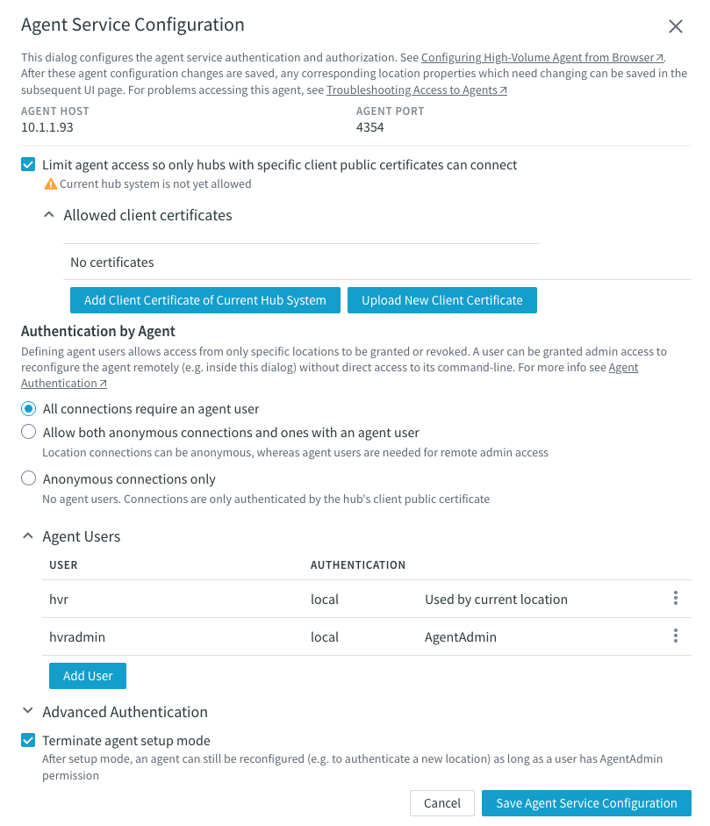
Configuration
Setting up an HVR Agent
During the first location setup after agent installation, users have to configure the agent settings: 1. Access to the agent can be limited based on the hub’s public certificate 2. Users can choose anonymous connection (only if agent access is limited)
3. Users can create agent user(s) for authentication
The agent can be re-configured later by enabling setup mode on the agent machine’s command line (this closes all connections to the agent) or by logging into the configuration window with an agent admin user.

Slide 21
Configuration
Setting up an HVR Agent
During the first location setup after agent installation, users have to configure the agent settings: 1. Access to the agent can be limited based on the hub’s public certificate 2. Users can choose anonymous connection (only if agent access is limited)
3. Users can create agent user(s) for authentication
The agent can be re-configured later by enabling setup mode on the agent machine’s command line (this closes all connections to the agent) or by logging into the configuration window with an agent admin user.

Slide 22
Configuration
Setting up an HVR Agent
During the first location setup after agent installation, users have to configure the agent settings: 1. Access to the agent can be limited based on the hub’s public certificate 2. Users can choose anonymous connection (only if agent access is limited)
3. Users can create agent user(s) for authentication
The agent can be re-configured later by enabling setup mode on the agent machine’s command line (this closes all connections to the agent) or by logging into the configuration window with an agent admin user.

Slide 23
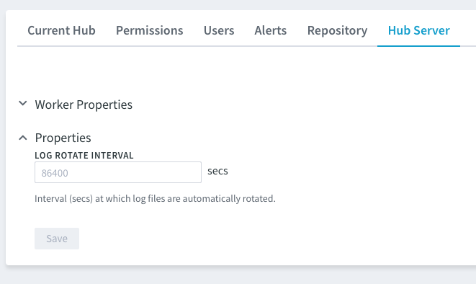
Log Rotation
Log rotation is the process of archiving log files from
$HVR_CONFIG/hubs/{hubname}/logs to the archive directory in $HVR_CONFIG/hubs/{hubname}/logarchives
Rotated files include both the hub server log and the log files specific to individual hubs.
Archived log files are always stored compressed.
These archived files are never purged by HVR.
Log rotation is an automated process without outage.
The rotation interval can be adjusted by configuring the Log Rotate Interval property in the hub settings.

Slide 24
HVR Upgrade / Uninstall

Slide 25
Upgrading HVR
First of all, always review the release notes to determine whether the hub, agent, or both need upgrades.
1
2
Create a backup of the $HVR_HOME and $HVR_CONFIG folders and, if you upgrade the hub machine, the hub repository database.
If you upgrade the hub, suspend all jobs. Stop the hvrhubserver (Hub) or hvragentlistener (Agent) OS process or service.
3
4
Unpack the new package into the $HVR_HOME folder (or run the installer on Windows).
Start the hvrhubserver (Hub) or hvragentlistener (Agent) process/service again.
If you upgraded the hub, reactivate all channels with “Jobs” and “Table Enrollment” options (some changes might require the “Capture Time and Transactions Files” component too).

Slide 26
Uninstalling HVR
1
2
Deactivate channels. If you are on consumption-based pricing, delete Hub system registration.
Stop the hvrhubserver and/or hvragentlistener OS process or service.
3
4
Drop metadata repository tables. Remove Hub repository database user.
Delete the HVR_HOME, HVR_CONFIG, HVR_TMP folders or use the uninstaller on Windows.

Slide 27
True or False? Archived log files are automatically purged after 7 days.
False.
The archived log files are never removed by HVR.

Slide 28
True or False? For implementing new code changes, it's essential to upgrade all agents and the hub.
False.
The requirements are always outlined in the release notes.

Slide 29
True or False? Uninstalling HVR removes the hub registration automatically.
False.
Hubs have to be de-registered manually.

Slide 30
Key Learnings
1
Learned about the preparation steps to an HVR installation.
Learned about Phone Home, and using the fivetran.com site to obtain new HVR installers.
Learned how to install HVR on Linux and Windows.
Learned how to perform an initial configuration of Hubs and Agents.
Learned how to upgrade and uninstall HVR
2
3
4
5

Slide 31
Q&A

